Slide 1

ACADEMIC RANKING OF WORLD UNIVERSITIES ANALYTICS
SATURDAY, 27TH AUGUST, 2022

Slide 2


TEAM DEEPLEARNING
Other active members
Emmanuel Ajibodu | Obiabuchi Nnanna
Ajeyomi Adedoyin | wolabi Adeniran
Paulina John | Udo Aniekan
Ugbo, Gregory Obinna | Imah Gift
Muftaudeen Toyin Saheed | Ezerioha, Ifeanyi Emmanuel
Philip Odewole | Etieneabasi Kingsley Effiong
Emmanuel Onuoha | Isaac Tamunoboma Ayotamuno
Jimoh Ridwan Adewale | Ogungbemi Oluwamayowa S.
Oladimeji Williams
Jadesola Kareem
Role: Presenter 1
Role: Presenter 2
Project Lead
Oladimeji Williams
Assistant Project Lead
Emmanuel Bolarinwa
Query Analyst
Jadesola Kareem

Slide 3
PROBLEM STATEMENT
Every year, thousands of people make the decision to attend a specific university. Choosing a university can be an overwhelming task and there are many factors to consider. The current university ranking system, such as the US News and World Report rankings, is a major factor in student decisions about where to attend school. While these rankings provide students with important information about the quality of a particular school, they should not be the only source of information used when making this important decision.
Hence, this project seeks to:
Determine the metrics that contribute to a university’s high ranking based on past university rankings records.
Develop a machine learning model that can predict the overall score of a university based on the important features.

Slide 4
EXISTING SOLUTIONS
The most well-known university rankings in the United States are those produced by U.S. News &World Report, Princeton Review, Forbes Magazine, and Business Insider.
The current university ranking system, such as the US News and World Report rankings, is a major factor in student decisions about where to attend school.
Rankings are based on a variety of factors such as student-faculty ratios, graduation rates, and the amount and quality of the courses offered.
University rankings also take into account institutional reputation and other factors that students value.
However, existing solutions do not take into consideration factors such as research intensity, university size, status, e.t.c.

Slide 5
OUR APPROACH
This project implored two different cleaning intuitions.
This first approach dropped all incomplete observations.
The second approach varies according to each column.
This project then developed a robust machine learning model.

Slide 6
DATASET DESCRIPTION
The source of the datasets is Kaggle.
The datasets contain rankings of about 1000 universities from around the world from the year 2018 to 2020, as maintained by Quacquarelli Symmonds(QS).
QS uses 6 factors for their ranking framework wiz.
Academic Reputation
Employer Reputation
Faculty to Student Ratio
Number of citations per faculty
International Faculty
International Students
Additionally, features like institution size, subject range, research intensity, age, and status are also included.

Slide 7
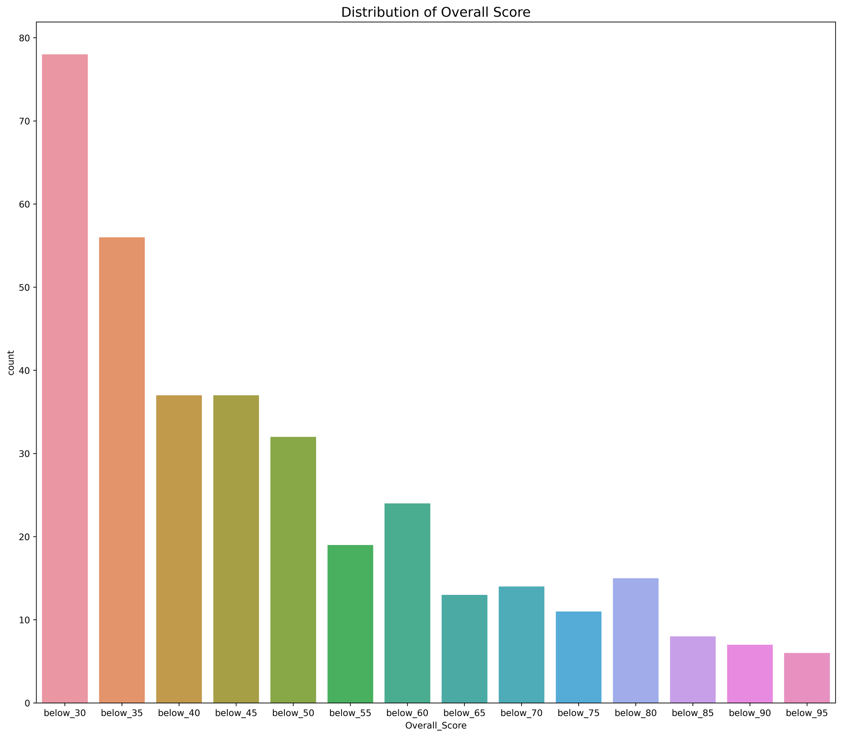
DATA EXPLORATIONS

Slide 8
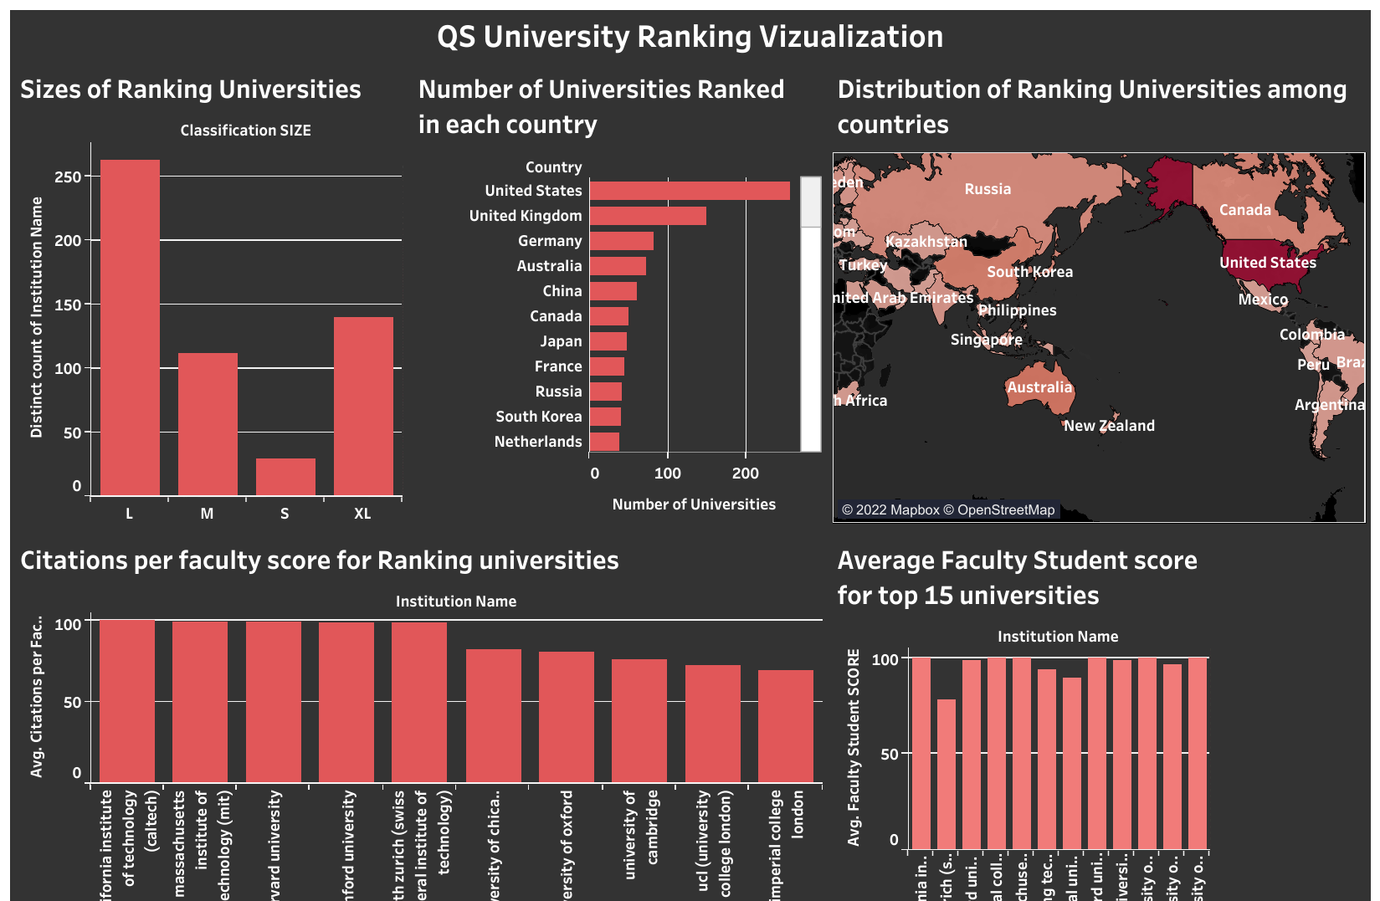
TABLEAU VISUALIZATION
A tableau dashboard is generated for further visualization.
Link

Slide 9
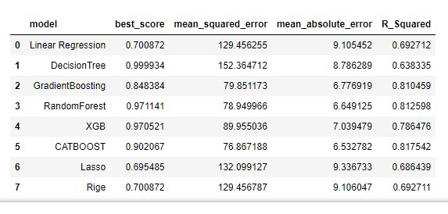
MODEL
Model Evaluation with all categorical variables dropped
Catboost gives a better mean absolute error value = 6.53

Slide 10
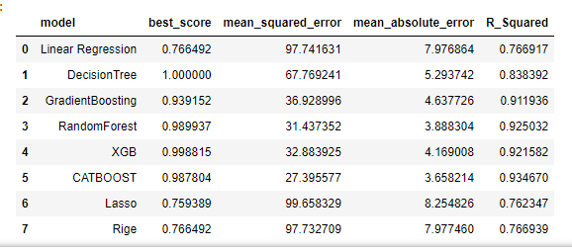
MODEL
Model Evaluation with all variables included.
Catboost gives a better mean absolute error value = 3.66

Slide 11

MODEL
Model Evaluation on the test dataset
Catboost gives a better mean absolute error value = 3.46

Slide 12
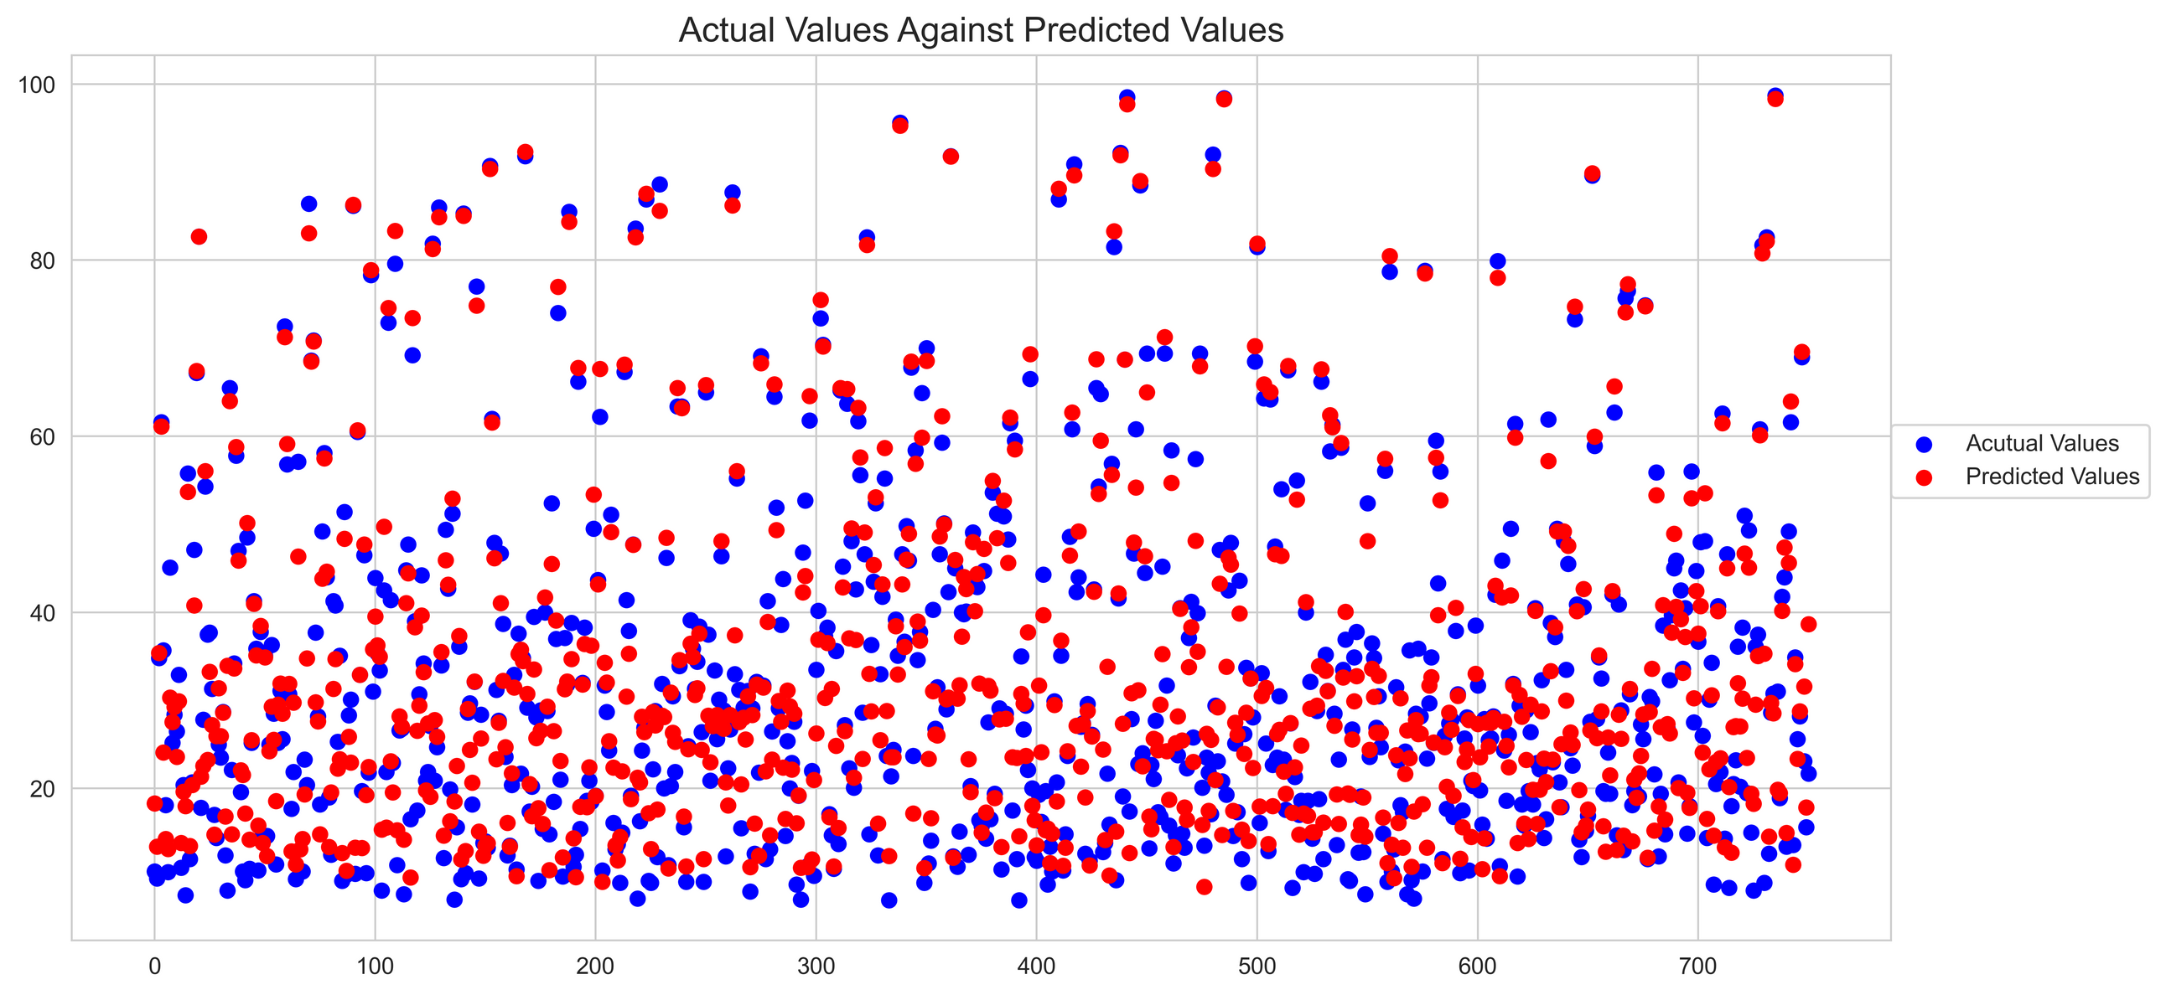
MODEL
Model Validation
We plotted the actual value of the data and then plotted an overlay of the predicted data to show how close the predicted points are to the actual points.

Slide 13
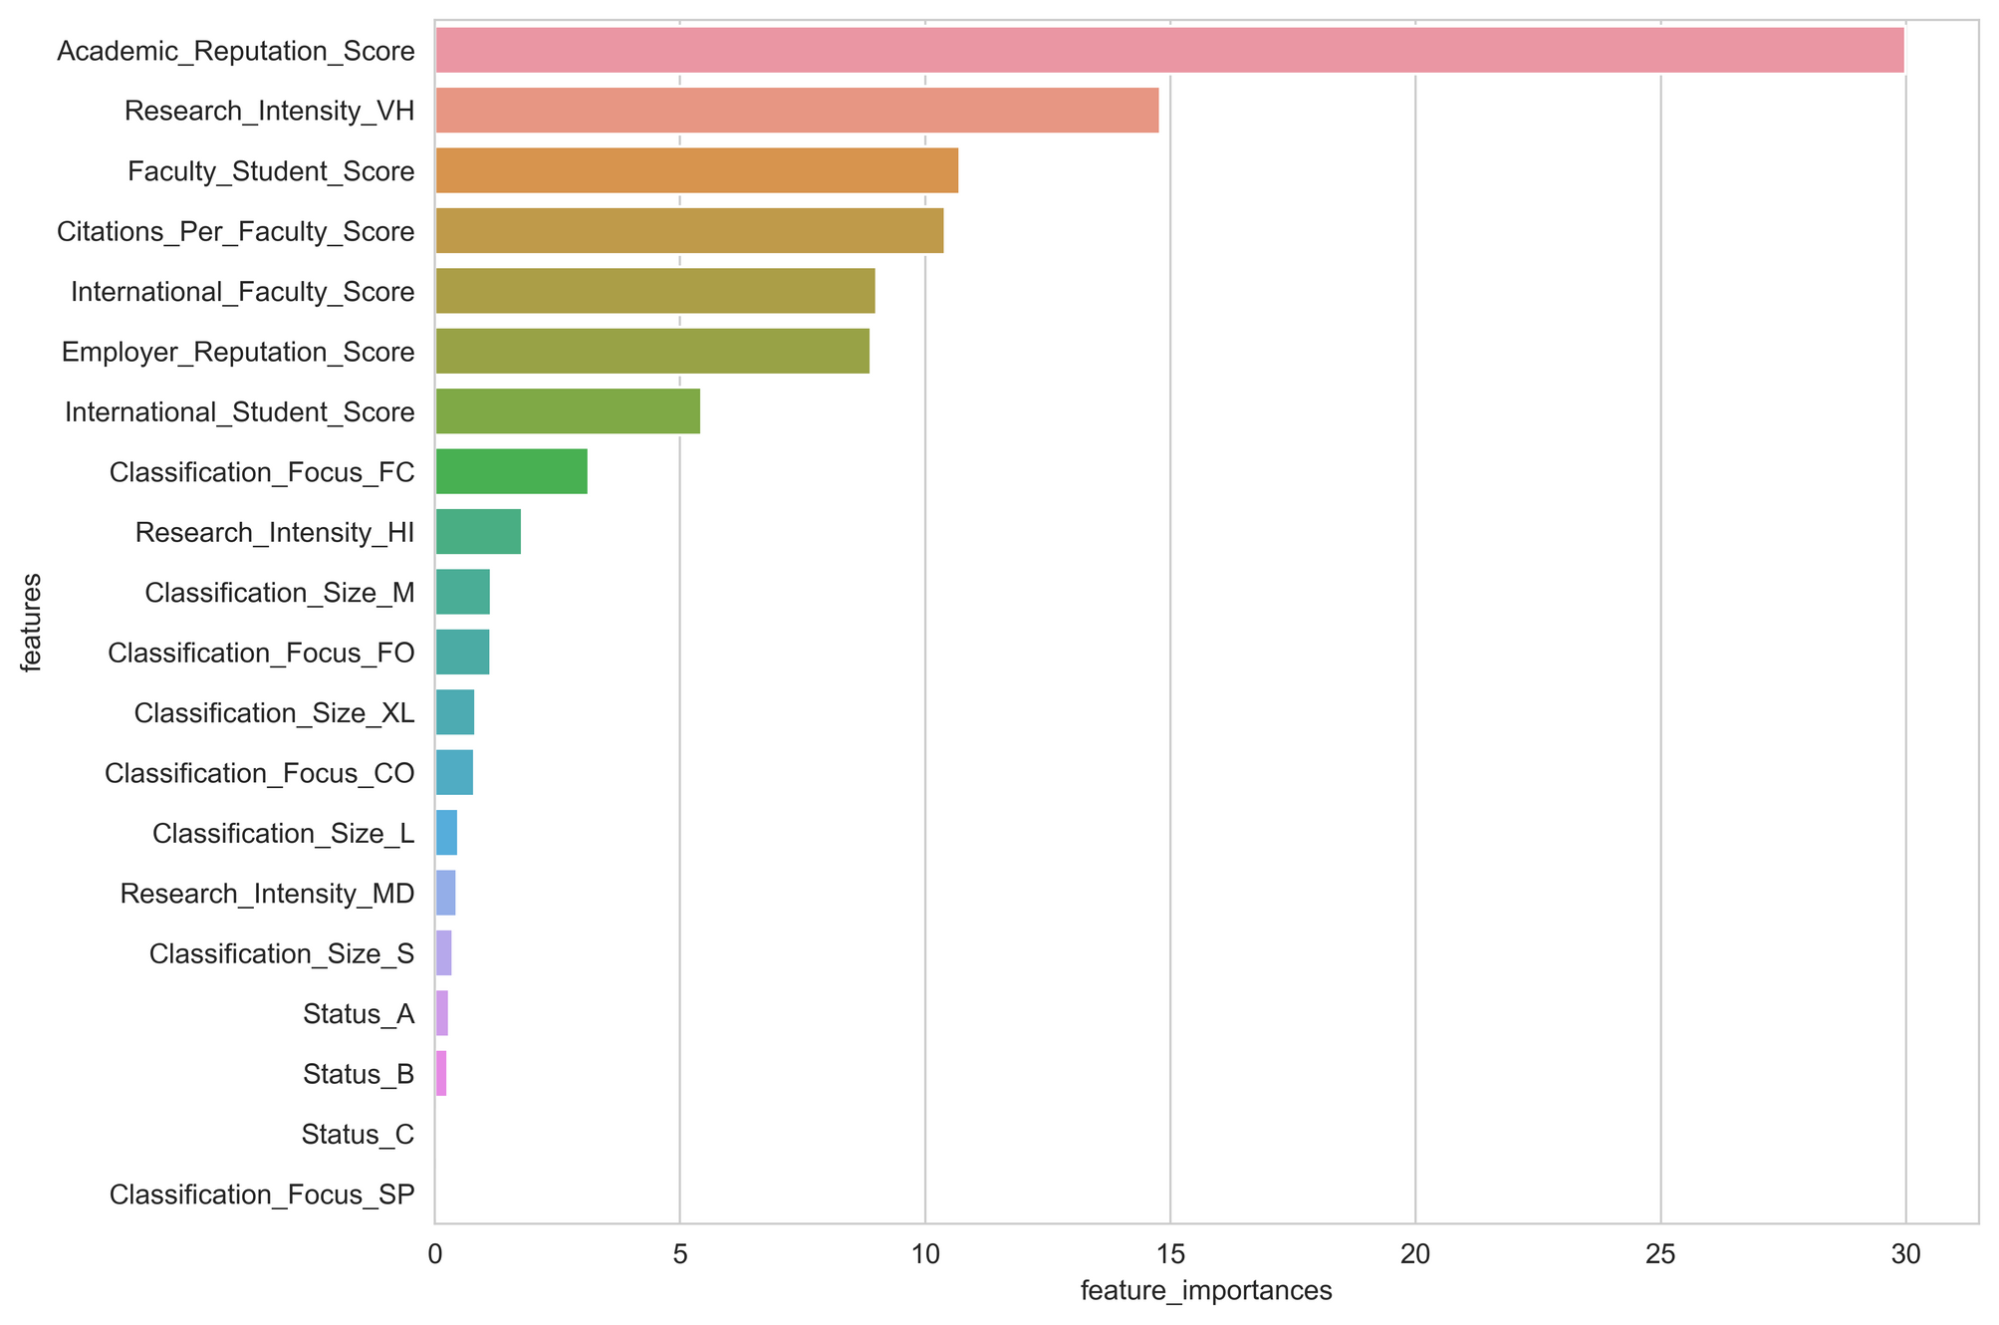
MODEL
Feature Importance

Slide 14


MODEL
Train
Encode with one hot encoder
Train a Catboosting model
Validate and make predictions the transformed data
Predict
Model Pipeline

Slide 15
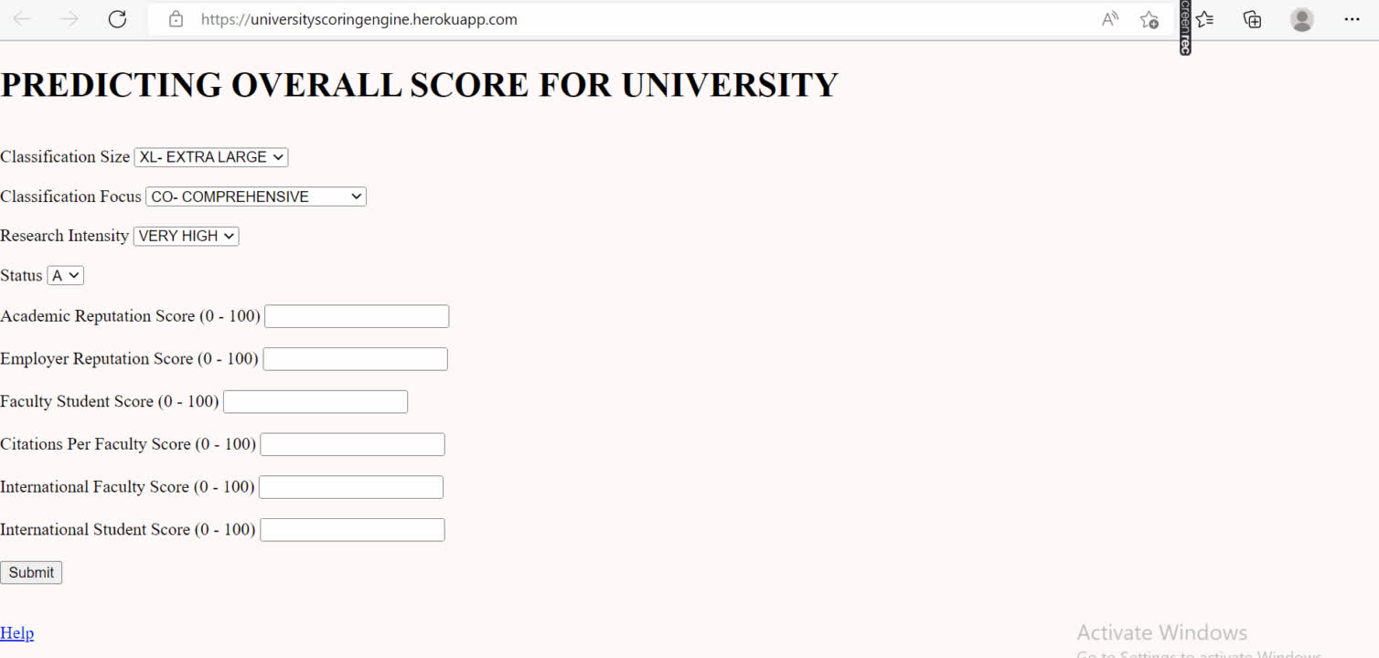
MODEL
Visit this link to view the deployed model

Slide 16
SUMMARY
In summary, we were able to successfully create a model that can predict the overall score of a university with a very good MAE value.
CHALLENGES
Amongst others, cleaning the dataset was tedious.

Slide 17
PROJECT LINKS
This engine can be used on http://universityscoringengine.herokuapp.com
You can react to this project on:
https://github.com/oadeniran/Hamoye-Team_deeplearning
https://www.canva.com/design/DAFJ9cXZSTM/w4seT4KLSbzOLsHxh3VfKg/view?utm_content=DAFJ9cXZSTM&utm_campaign=designshare&utm_medium=link2&utm_source=sharebutton

